Slide 1
Lecture 3 Basics of Research I

Slide 2
In todays class, we will see some important terminologies in RM , but before that
What is the difference between Research Methodology and Research Methods?
Methodology refers to- The theory of how research should be undertaken- philosophy and the processes of creating the knowledge, and
Methods refer to -The tools, techniques and procedures used to obtain and analyse data.
Key elements of the Research Methodology
Research philosophy
Research approach
Research strategy
Quantitative versus Qualitative (Design)
Research methods

Slide 3
Scientific Process for Research
Scientific Inquiry
Ask a question
Research the topic
Formulate a hypothesis
Test the hypothesis
Analyze the data
Interpret the data and draw conclusions

Slide 4
Key Concepts in Research
ONTOLOGY: The Researcher’s view of the nature of reality or a state of being
EPISTOMOLOGY: The Researcher’s view regarding what constitutes acceptable knowledge in a discipline.
AXIOLOGY: The Researcher’s view of the role of values in research
Values are the researcher’s personal beliefs or feelings

Slide 5
Linking the three terms
Ontology involves the philosophy of reality,
Epistemology addresses how we come to know that reality while
Methodology identifies the particular practices and tools used to attain knowledge .
Epistemology poses the following questions: What is the relationship between the knower and what is known? How do we know what we know? What counts as knowledge?

Slide 6
RESEARCH PHILOSOPHY
How knowledge is developed and the nature of that knowledge
Three BROAD PHILOSOPHICAL VIEWS
POSITIVISM
INTERPRETIVISM
PRAGMATISM

Slide 7
POSITIVISM
Refers to the assumption that all phenomena, whether physical, natural, social, or psychological, exhibit persistent pattern or regularities that can be studied.
According to positivism, there are only two sources of knowledge: logical reasoning and empirical experience. It advocates the application of the methods of the natural sciences to the study of social reality and beyond.

Slide 8
Adopts the philosophical stance of the natural scientist
The end product of this research can be law-like generalisations
Uses highly structured methodology in order to facilitate replication
Emphases is on quantifiable ( number based) observations – number based data

Slide 9
INTERPRETIVISM
A contrasting epistemology to positivism
View the subject matter of the Social sciences/ Management Business Research -people and their institutions as being fundamentally different from that of the natural sciences.
The study of the social world therefore requires a different logic of research procedure, one that reflects the distinctiveness of humans as against the natural order.

Slide 10
INTERPRETIVISM
Advocates that:
It is necessary for the researcher to understand and differentiate between humans in our role as researchers
Requires the researcher to grasp the subjective meaning of social action
Seen by some to be more appropriate to Management Research

Slide 11
PRAGMATISM
There is no one position to adopt
The most important determinant of the epistemology, ontology and axiology you adopt is the research question- One may be more appropriate to answering the question than the other
It may be more appropriate to think of the philosophies adopted as a continuum rather than opposite positions Tashakori and Teddlie (1998).

Slide 12
APPROACHES TO RESEARCH
THEORY
Theory proposes abstract principles to explain and predict phenomena. Scientific theories provide a basic framework within which scientific inquiry can take place. Scientific theories are based on the
Two types OF Approaches :
DEDUCTIVE
INDUCTIVE

Slide 13
DEDUCTIVE
TESTING THEORY
DOMINANT APPROACH IN THE NATURAL SCIENCES, numeric data
Also called Top Down approach
Five sequential stages of Deductive research Robson (2002) :
1. FORMULATING/ DEDUCING A HYPOTHESES FROM THEORY
2. EXPRESSING THE HYPOTHESIS IN AN OPERATIONAL FORM (how the concepts and variable will be measured)
3. TESTING THE HYPOTHESIS (using strategies)
4. EXAMINING THE SPECIFIC OUTCOME OF THE INQUIRY
5. MODIFY THE THEORY IF NECESSARY

Slide 14
INDUCTIVE
BUILDING THEORY
ORIGINATES IN THE SOCIAL SCIENCES
ALSO CALLED BOTTOM UP APPROACH.

Slide 15
Research Approaches: Deductive Vs Inductive
a deductive approach starts with theory and looks to test and generalise
an inductive approach starts with data, looks for patterns and generates theory as understanding emerges from the data. ...

Slide 16
Characteristics of Deductive Approach
Explaining causal relationships between variables
Establishing controls for testing hypotheses
Independent of the researcher
Concepts operationalised for quantitative measurement
Generalisation

Slide 17
Characteristics of Inductive Approach
Understanding the way human build their world
Permitting alternative explanations of what’s going on
Being concerned with the context of events
Using more qualitative data
Using a variety of data collection methods

Slide 18
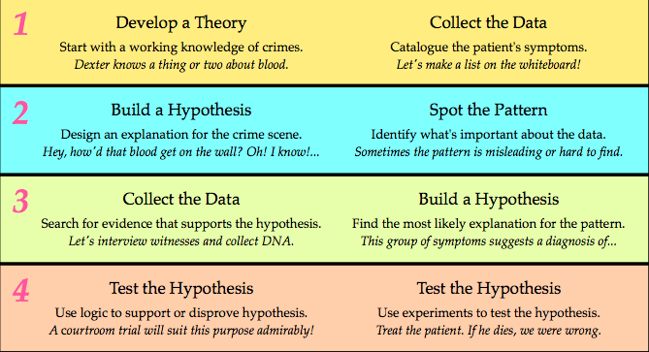
Deductive
Inductive

Slide 19
The approach you take needs to be consistent
Positivist Research Philosophy
Deductive Research Approach
Research design choices
Quantitative strategies
Interpretivist Philosophy
Inductive Approach
Research design choices
Qualitative strategies

Slide 20
DEDUCTIVE AND INDUCTIVE DIFFERENCES BETWEEN APPROACHES ABDUCTIVE
DEDUCTION EMPHASIS
INDUCTION EMPHASIS
Scientific principles
Moving from theory to data
The need to explain causal relationships between variables
Collection of quantitative data
The application of controls to ensure validity of data
The operationalisation of concepts to ensure clarity of definition
Highly structured approach
Researcher independence of what is being researched
The necessity to select samples of sufficient size in order to generalise conclusion
Gaining an understanding of the meanings humans attach to events
A close understanding of the research context
The collection of qualitative data
A more flexible structure to permit changes of research emphasis as the research progresses
A realisation that the researcher is part of the research process
Less concern with the need to generalise

Slide 21
In the next class, we will continue with Research strategy ..

